Slide 1


E-STIU APPLICATION
"One touch to a better future"

Slide 2
Introduction
E-STIU is an app designed for Stamford International Students and Staff to get easy information from both reg.stamford.edu and learn.stamford.edu.
Design Team
Project Manager: Mr. Steven Bostock
Project Assistant: Mr. Jeremiah Pixly
Project Members: Mr. Yihang Gao
Ms. Thaksaporn Kumkaew
Ms. Fardina Kabir
Mr. Fan Yang

Slide 3
Key StakeHolders
Client​ | Stamford International University​
Sponsor​ | Teacher Siriporn Thitalampoon​
Project Manager​ | Mr. Steven Bostock​
Project assistant​ | Mr. Jeremiah Pixley​
Project Members​ ​ ​ | Mr. Fan Yang​ Mr. Yihang Guo​ Ms.Thaksaporn Kumkaew​ Ms.Fardina Kabir​

Slide 4
Goals of E-STIU
Receive approval from Stamford Internatnal University.
Gather materials and staff members.
Design UI for E-STIU that is simple but stylish.
Implement a grade tracking system.
Be able to receive and send accouncements.
Track forigne students Visa dates and announcements.

Slide 5
Intended features
Understandable UI for all users
Combines information from both websites.
Visa notifications
Grade Tracking for each student
Receive announcements from Stamford, Classes, Students and Events

Slide 6
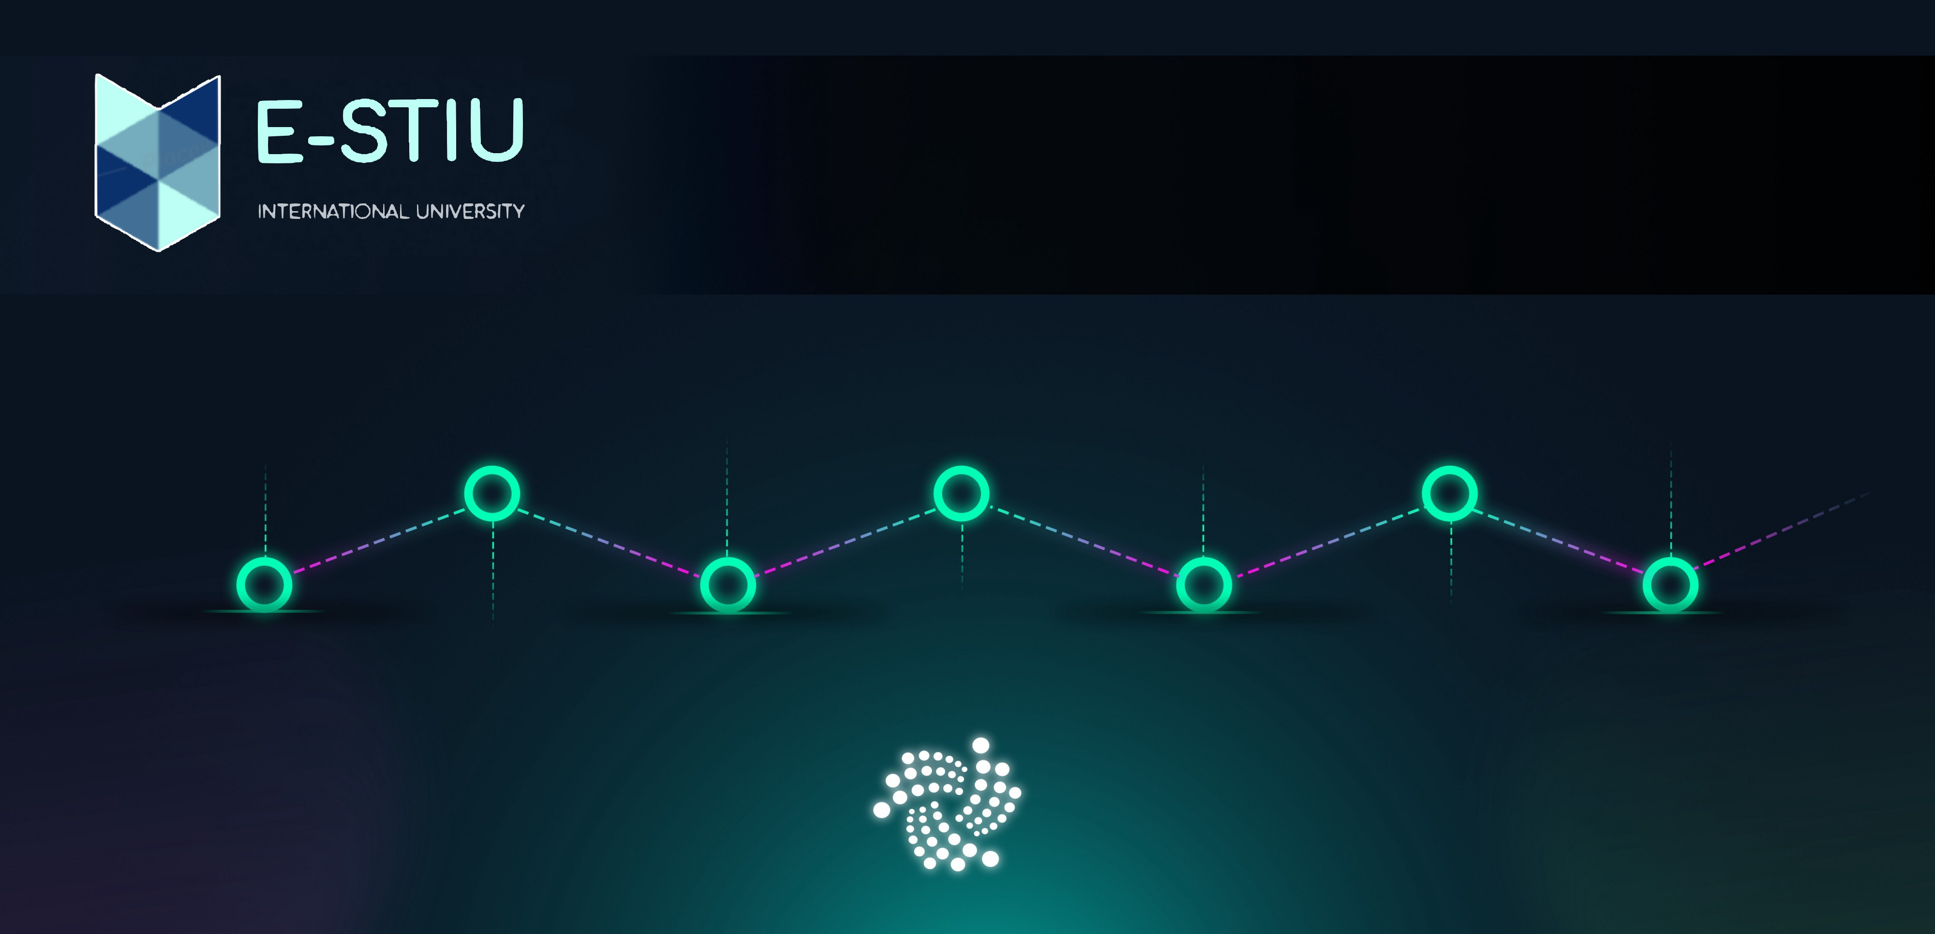
Roadmap of E-STIU
Grade tracker
Bug fixing and launch
Begin development
August 31, 2020
November 31, 2020
Visa tab
May 31, 2021
Launch
Minor testing phase
Major testing phase
July 22, 2020
UI-Development
October 31,2020
December 31, 2020
June 31, 2021
Notes:
Scott

Slide 7
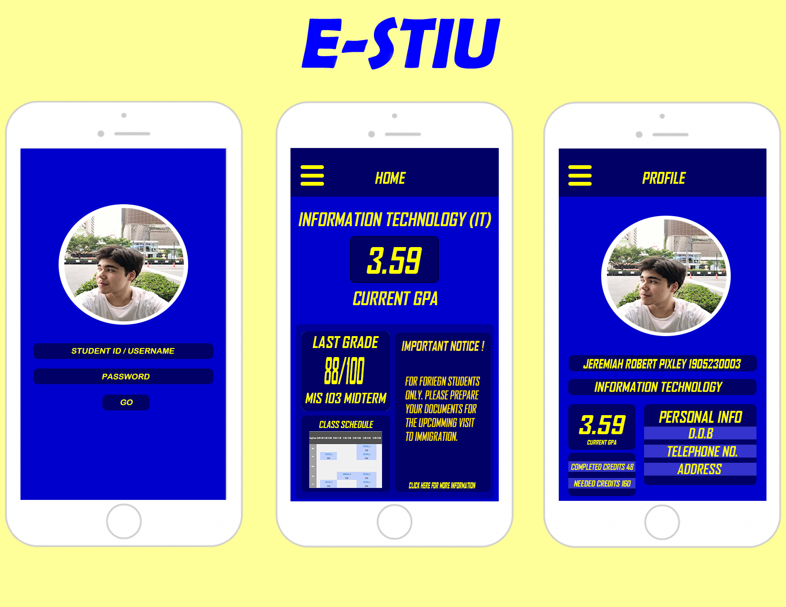
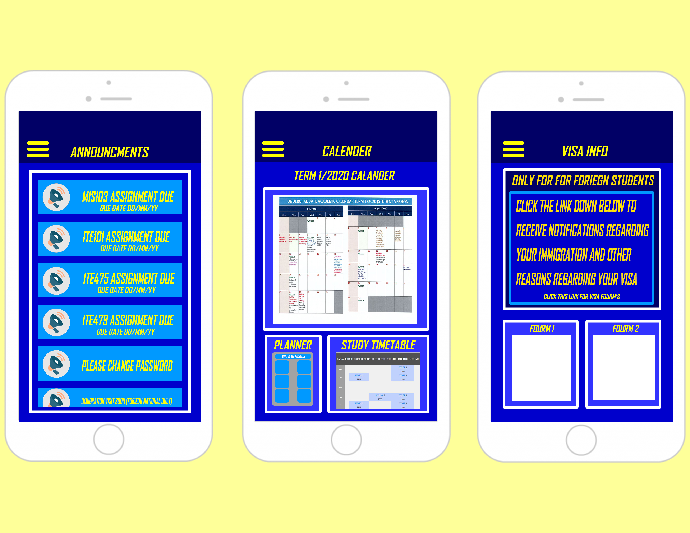
E-STIU UI

Slide 8
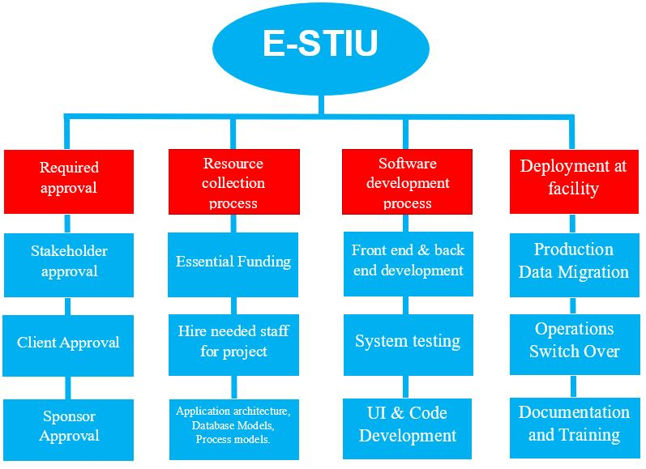
E-STIU WBS

Slide 9
S.W.O.T
Strengths​ | -Easy to use​ -Easy communication to students and teachers​ -For students and teachers and staff members only​ -Free​ -Combines both the websites into one app​ -Can be used on any platform (Except Gaming consoles)​ -Multi-factor authentication.​
Weakness​ | -Free​ -For students and teachers and staff members only​ -Needs a constant internet connection​ -Possibility of crashes​
Opportunity​ | -Can be developed further​ -Can use the app to connect to other universities that are partnered to Stamford to improve the business and academic success of STIU.​
Threats​ | -Possibility of Security issues : ​ Encryption failure if consumer and enterprise devices do not have encryption enabled, then hackers may hack personal plain data.​ Setting of strong or weak passwords and its maintenance depends on users, e.g. if password is related to personal information, then can be hacked.​ If account is hacked the hacker may be able to change personal information which will mess with the students or staff. Hacker may cause server issues example: Server crash, Lag or shutdown

Slide 10
Constraints, Assumptions, Risks and Dependencies
Constraints​ | Password limitation, Internet connection, Data storage​, University regulations.
Assumptions​ | Fully functional, Easy to access/use, Understandable for all ages, multi-factor authentication​, High security.
Risks​ | Information leaks, System malfunction due to weak internet,​ Capital chain rupture, The government or university put forward new policies to limit it, Low data storage and problems in coding by developers.​
Dependencies​ | Internet opinion, University usage, Programmers/Coders/App developers, Feedback, Investment institutions.

Slide 11
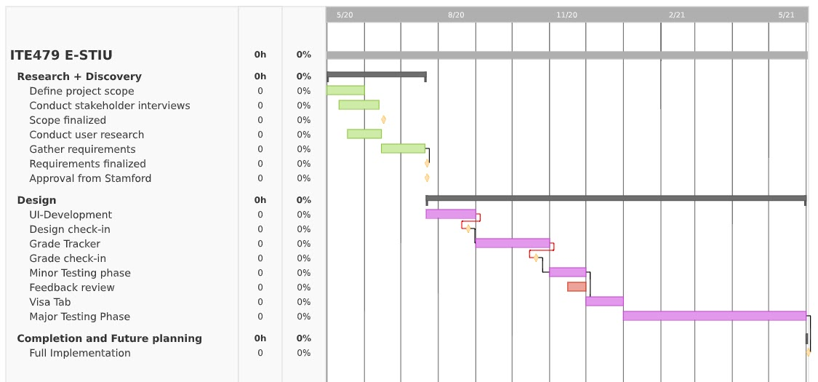
E-STIU Gantt Chart

Slide 12
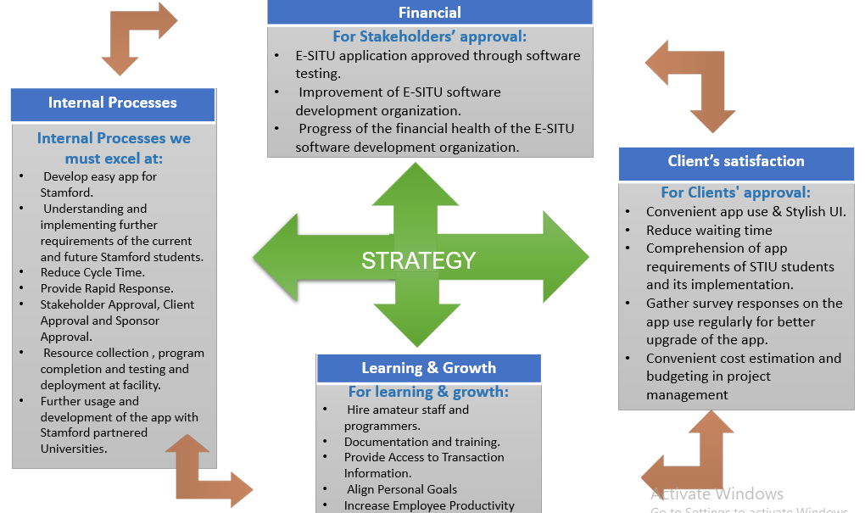
Scorecard

Slide 13
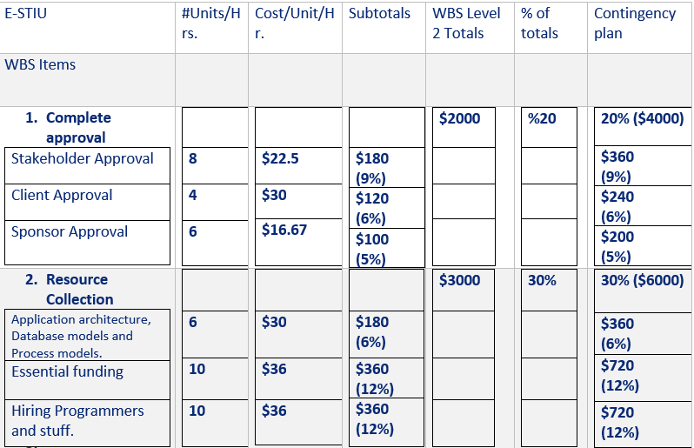
E-STIU BUDGET ANALSIS

Slide 14
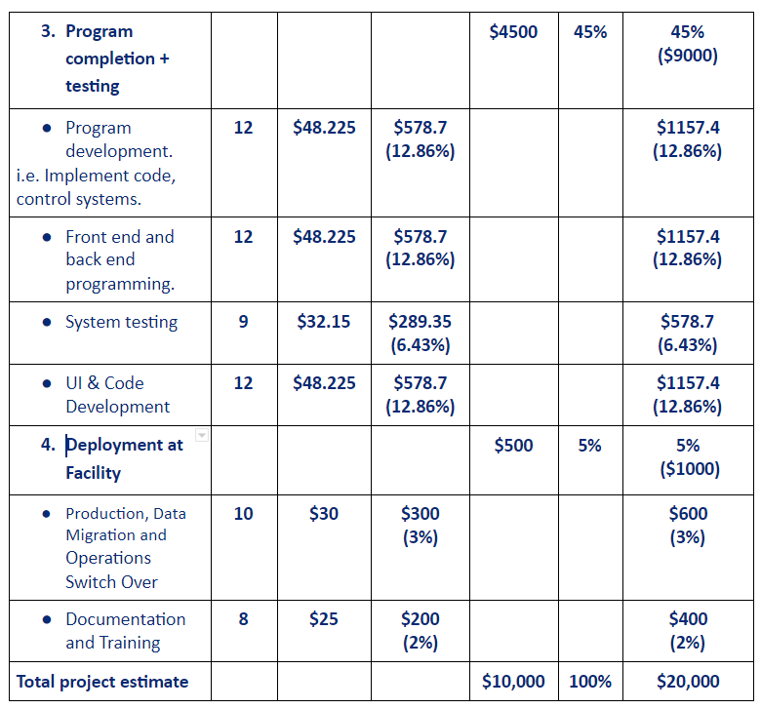
E-STIU BUDGET ANALSIS

Slide 15

Thank you for Listening

